Slide 1
IBM University Engagement Project Submission
“Exploring the Power of Agentic AI with IBM Granite and LangFlow”

Slide 2
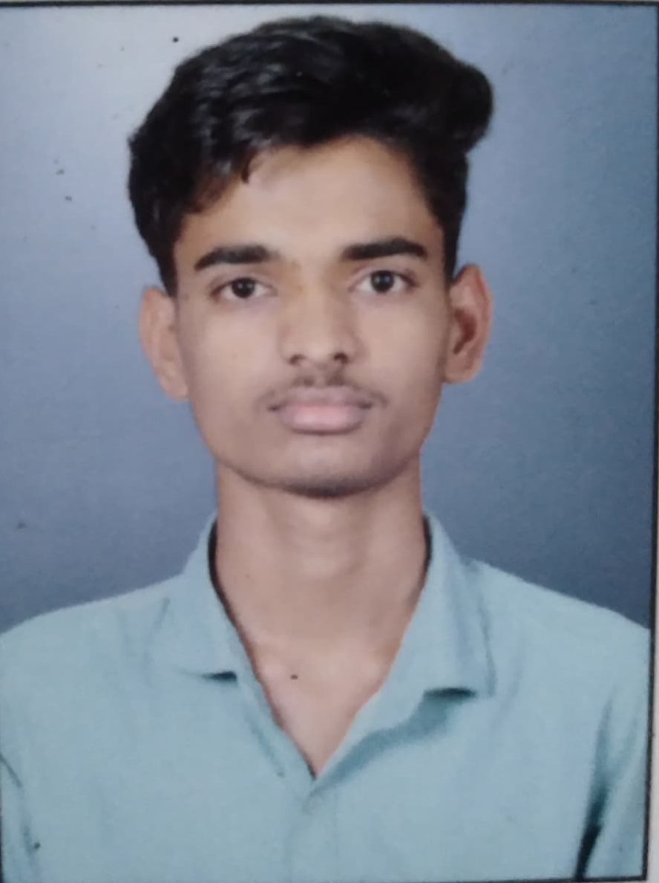
Project Tile – LearnMate – Agentic AI for Personalized Course Pathways
Domain of Project – Education
Student Name | Recent Passport Photo | Email ID | Mobile number [WhatsApp]
Yash Mohan Mahalle |  | mahalleyash46@gmail.com | 9511807642

Slide 3
Problem Statement -
Problem Statement :Personalized Course Pathways
The Challenge
Lack of personalized guidance, skill-gap identification, and adaptive recommendations leads to inefficient learning journeys.
The Objective
• Personalized learning roadmaps
• Skill-gap analysis
• Dynamic recommendations
• Career guidance
• Progress tracking

Slide 4
Technology Used -
LangFlow
IBM watsonx.ai
IBM Granite 4.0 Instruct
RAG
Python
Streamlit
ChromaDB

Slide 5
Proposed Solution -
Proposed Solution: Agentic AI for Personalized Course Pathways
LearnMate uses Agentic AI, LangFlow, IBM watsonx.ai, and Granite Models
to analyze student profiles and generate adaptive learning pathways.

Slide 6
Langflow component Used -
Chat Input
Prompt Template
Retriever
Vector Store
IBM Agent
Granite Model
Memory
Chat Output

Slide 7
Langflow workflow –
User Input → Profile Analysis → Skill Assessment → RAG Retrieval → Recommendation Agent → Progress Tracking → Career Guidance

Slide 8
Architecture blueprint –
Student → Streamlit UI → LangFlow → Multi-Agent Layer → IBM Granite Model → RAG Database → Personalized Roadmap

Slide 9
Role of Agentic AI in the solution
Role of Agentic AI
Autonomous agents collaborate to understand user goals, assess skills, recommend courses, and adapt learning pathways

Slide 10
Novelty and Uniqueness
Multi-Agent AI
Adaptive Recommendations
Career Alignment
RAG-Based Knowledge Retrieval
Scalable Design

Slide 11
Future Scope -
Resume Analyzer
Interview Coach
Internship Recommendation
Multilingual Support
Industry Integration
·
·
·

Slide 12
Git Hub Link
Github URL –
https://github.com/yash-mahalle/Agentic-AI-for-Personalized-Course-Pathways.git

Slide 13
Thank You

